Slide 1
New Campus Surrounding Services
Subway Lines
3 subway stations in total within 1000m around new campus
Zhongguancun Station of subway line 4, Distance 900m
Suzhoujie Station of subway line 10, Distance 800m
Haidian Huangzhuang Station of subway line 10, Distance 1000m
Bus lines
8 bus stops in total around new campus
Banking Services
48 banking services points, including savings bank, sub-branch, ATM and self-service bank
A vast majority of them contracted to China Union Pay
ICBC and BOC ATMs within new campus
Food and Beverage
24 food-and-beverage service providers totally
Including Chinese restaurants, Western fast food, coffee shops (3 Starbucks) and bakeries

Slide 2
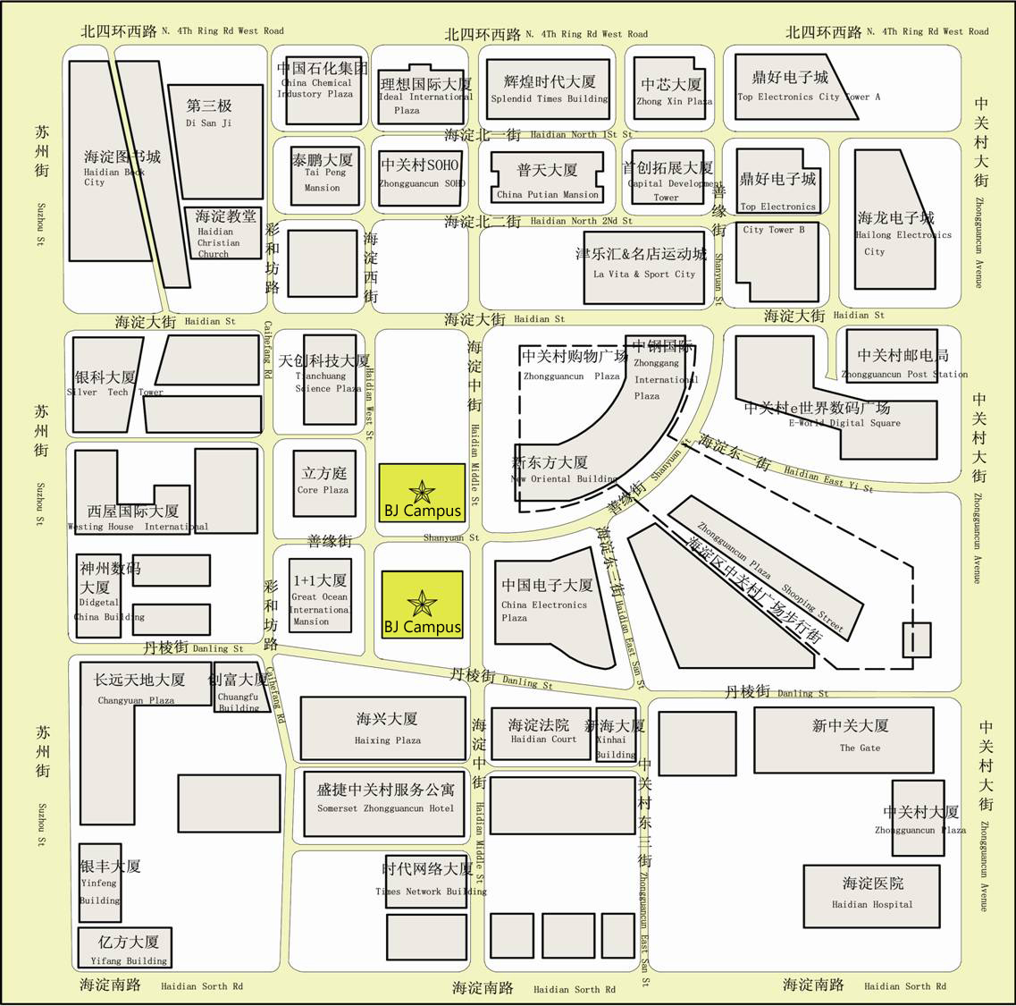







Surrounding Services Map
Bus line
Subway line
New Campus Surrounding Services
Banks and ATMs
Food and Beverage

Slide 3
Backup Appendix

Slide 4
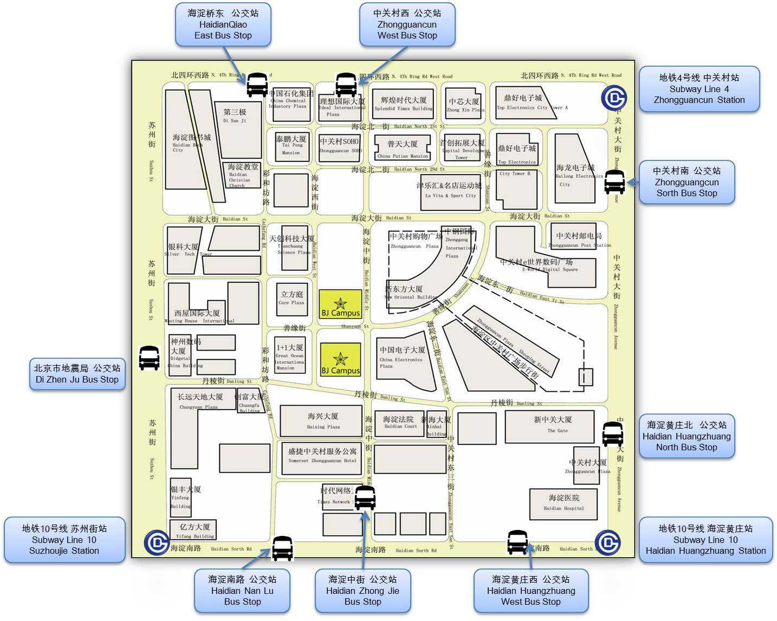
Appendix 1 Subway and Bus Lines

Slide 5
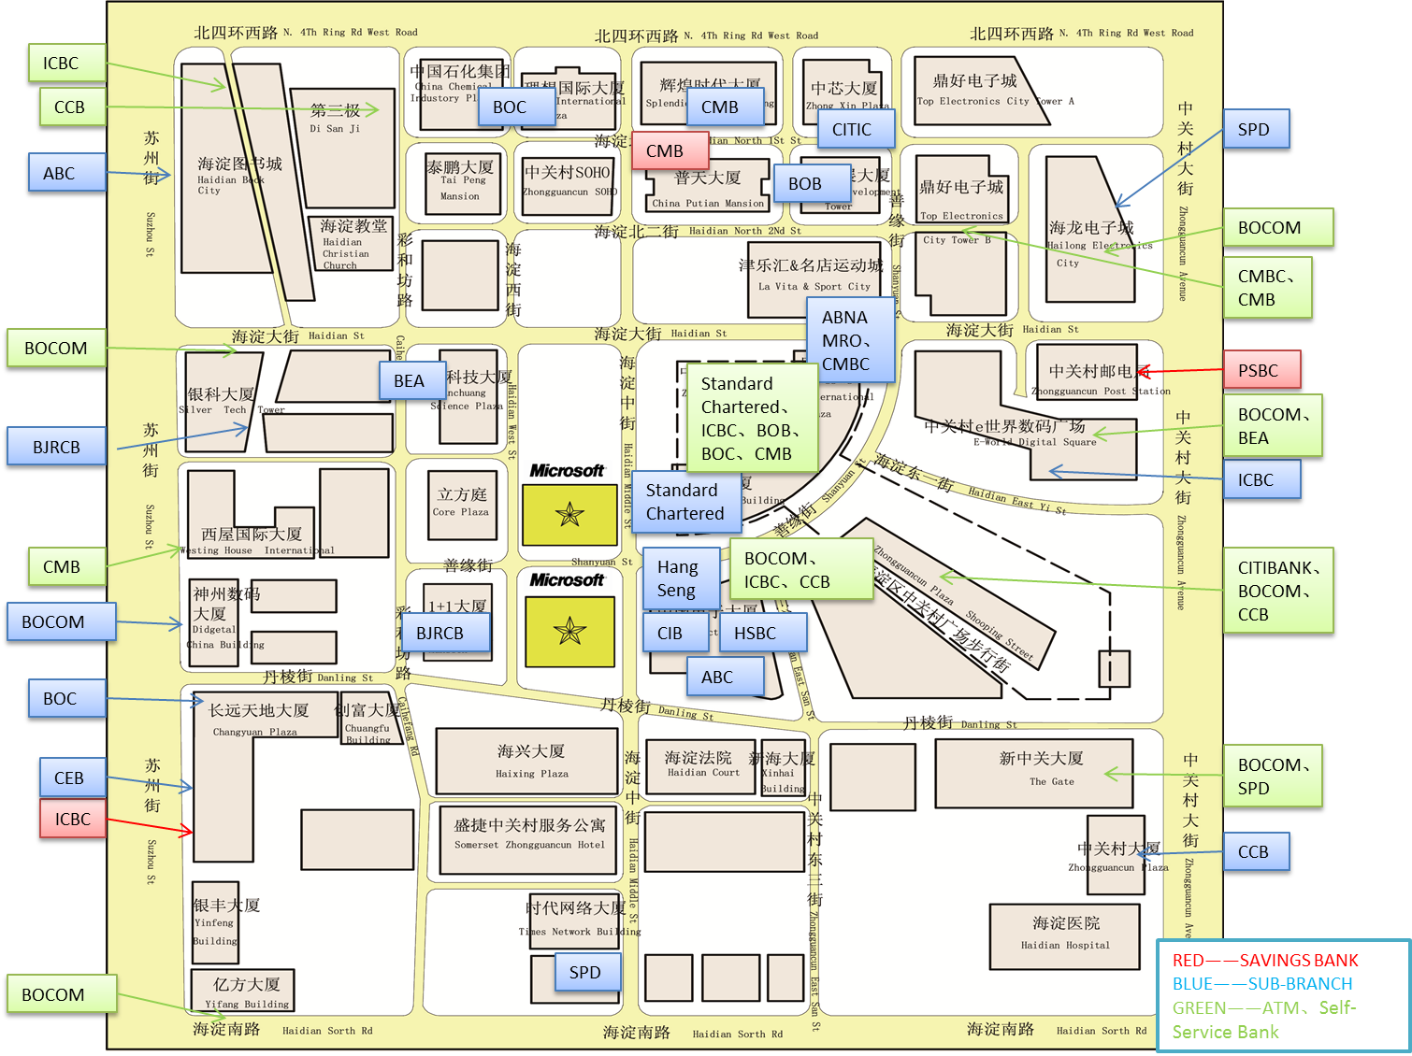
Appendix 2 Banking Services

Slide 6




















Appendix 3 Food and Beverage

